Slide 1

Ebode Camera Security Analysis
DXD946, MXY995, RXF964, HXX953, YXL1178

Slide 2
Initial research
Reading packaging and manuals
Connected via ethernet
Possible server setup
Firmware Structure
Firmware Reverse Engineering
Web Connection
Network Analysis
Common Vulnerabilities

Slide 3
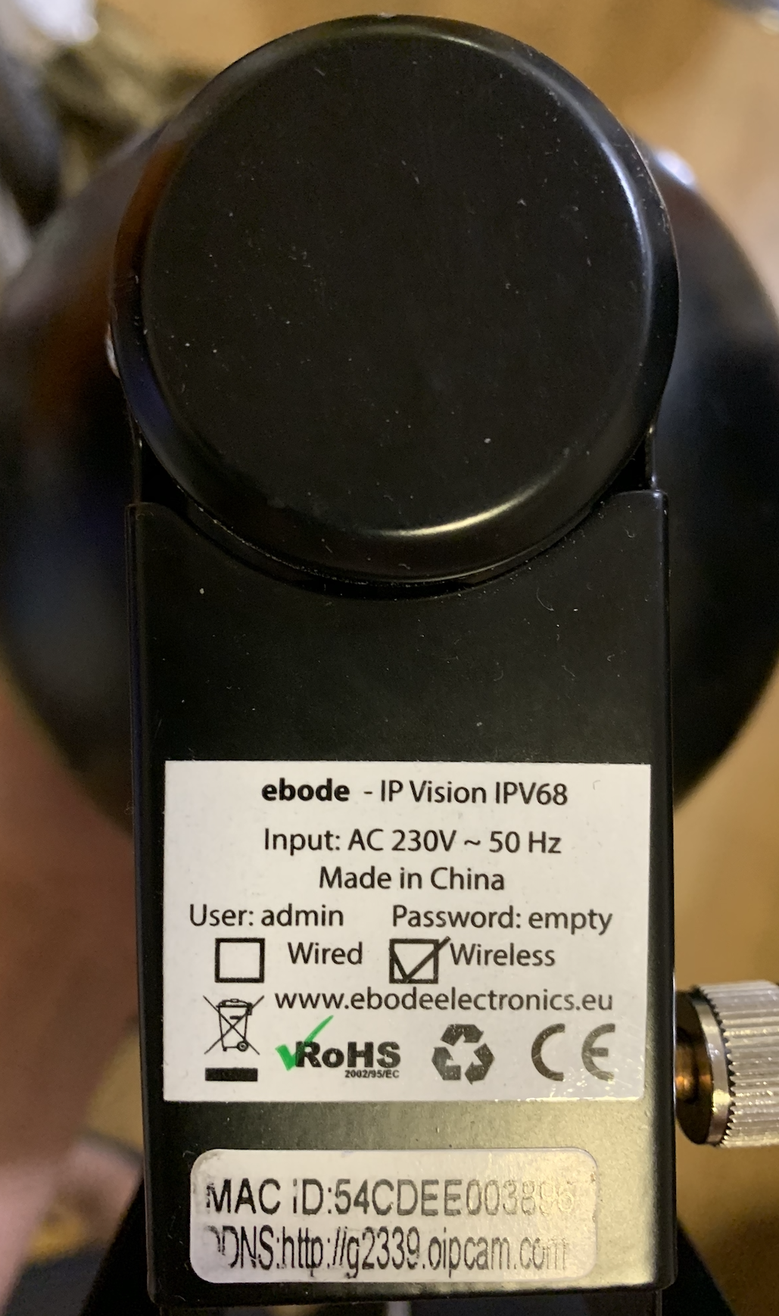
Basic Information
Hardware
MAC ID：54CDEE003896
DDNS：http://g2339.oipcam.com (expired)
Default username/password: admin/<empty>

Slide 4
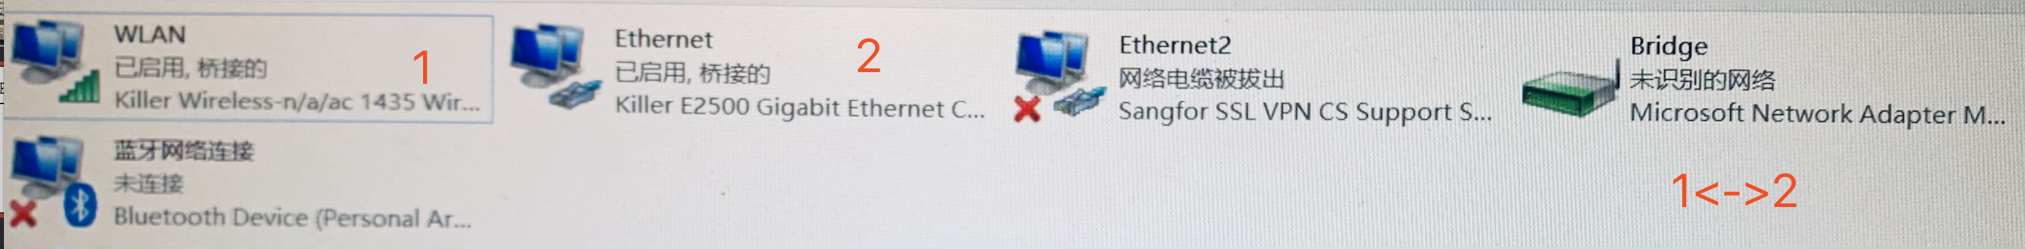
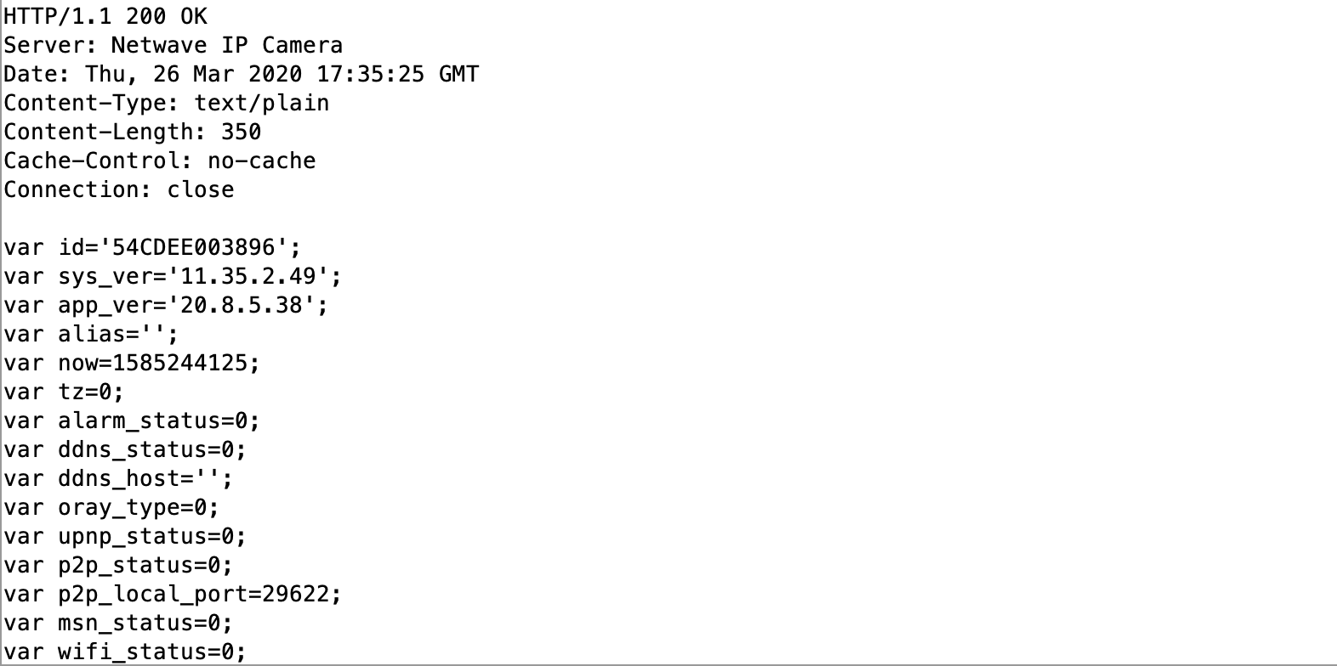
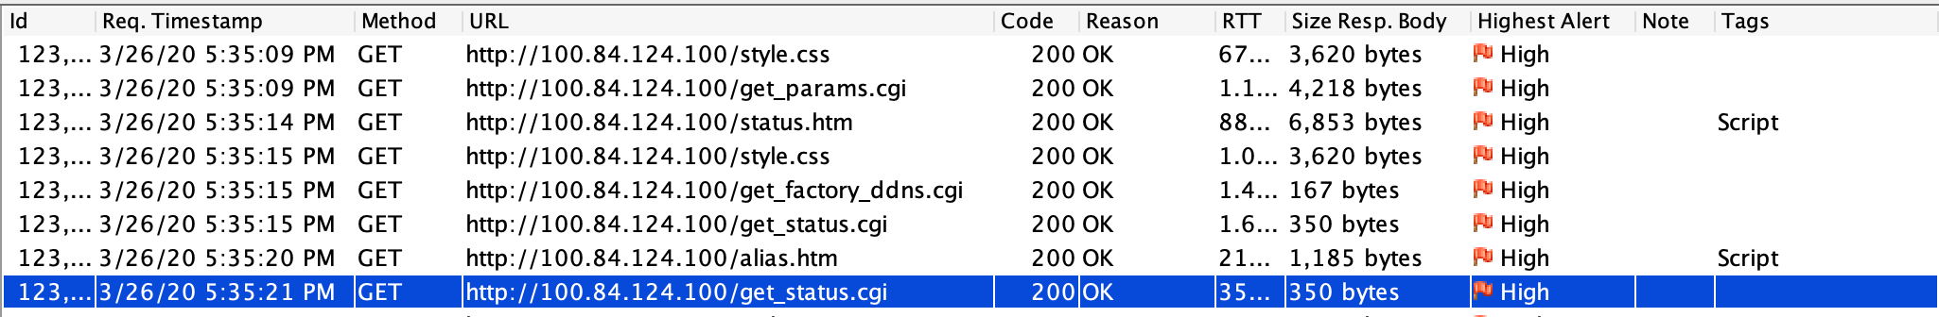
Setup
Setting a bridge between Wireless network and Ethernet network
Intercepting HTTP traffic

Slide 5
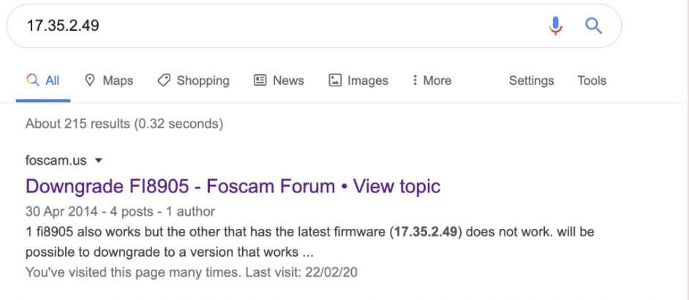
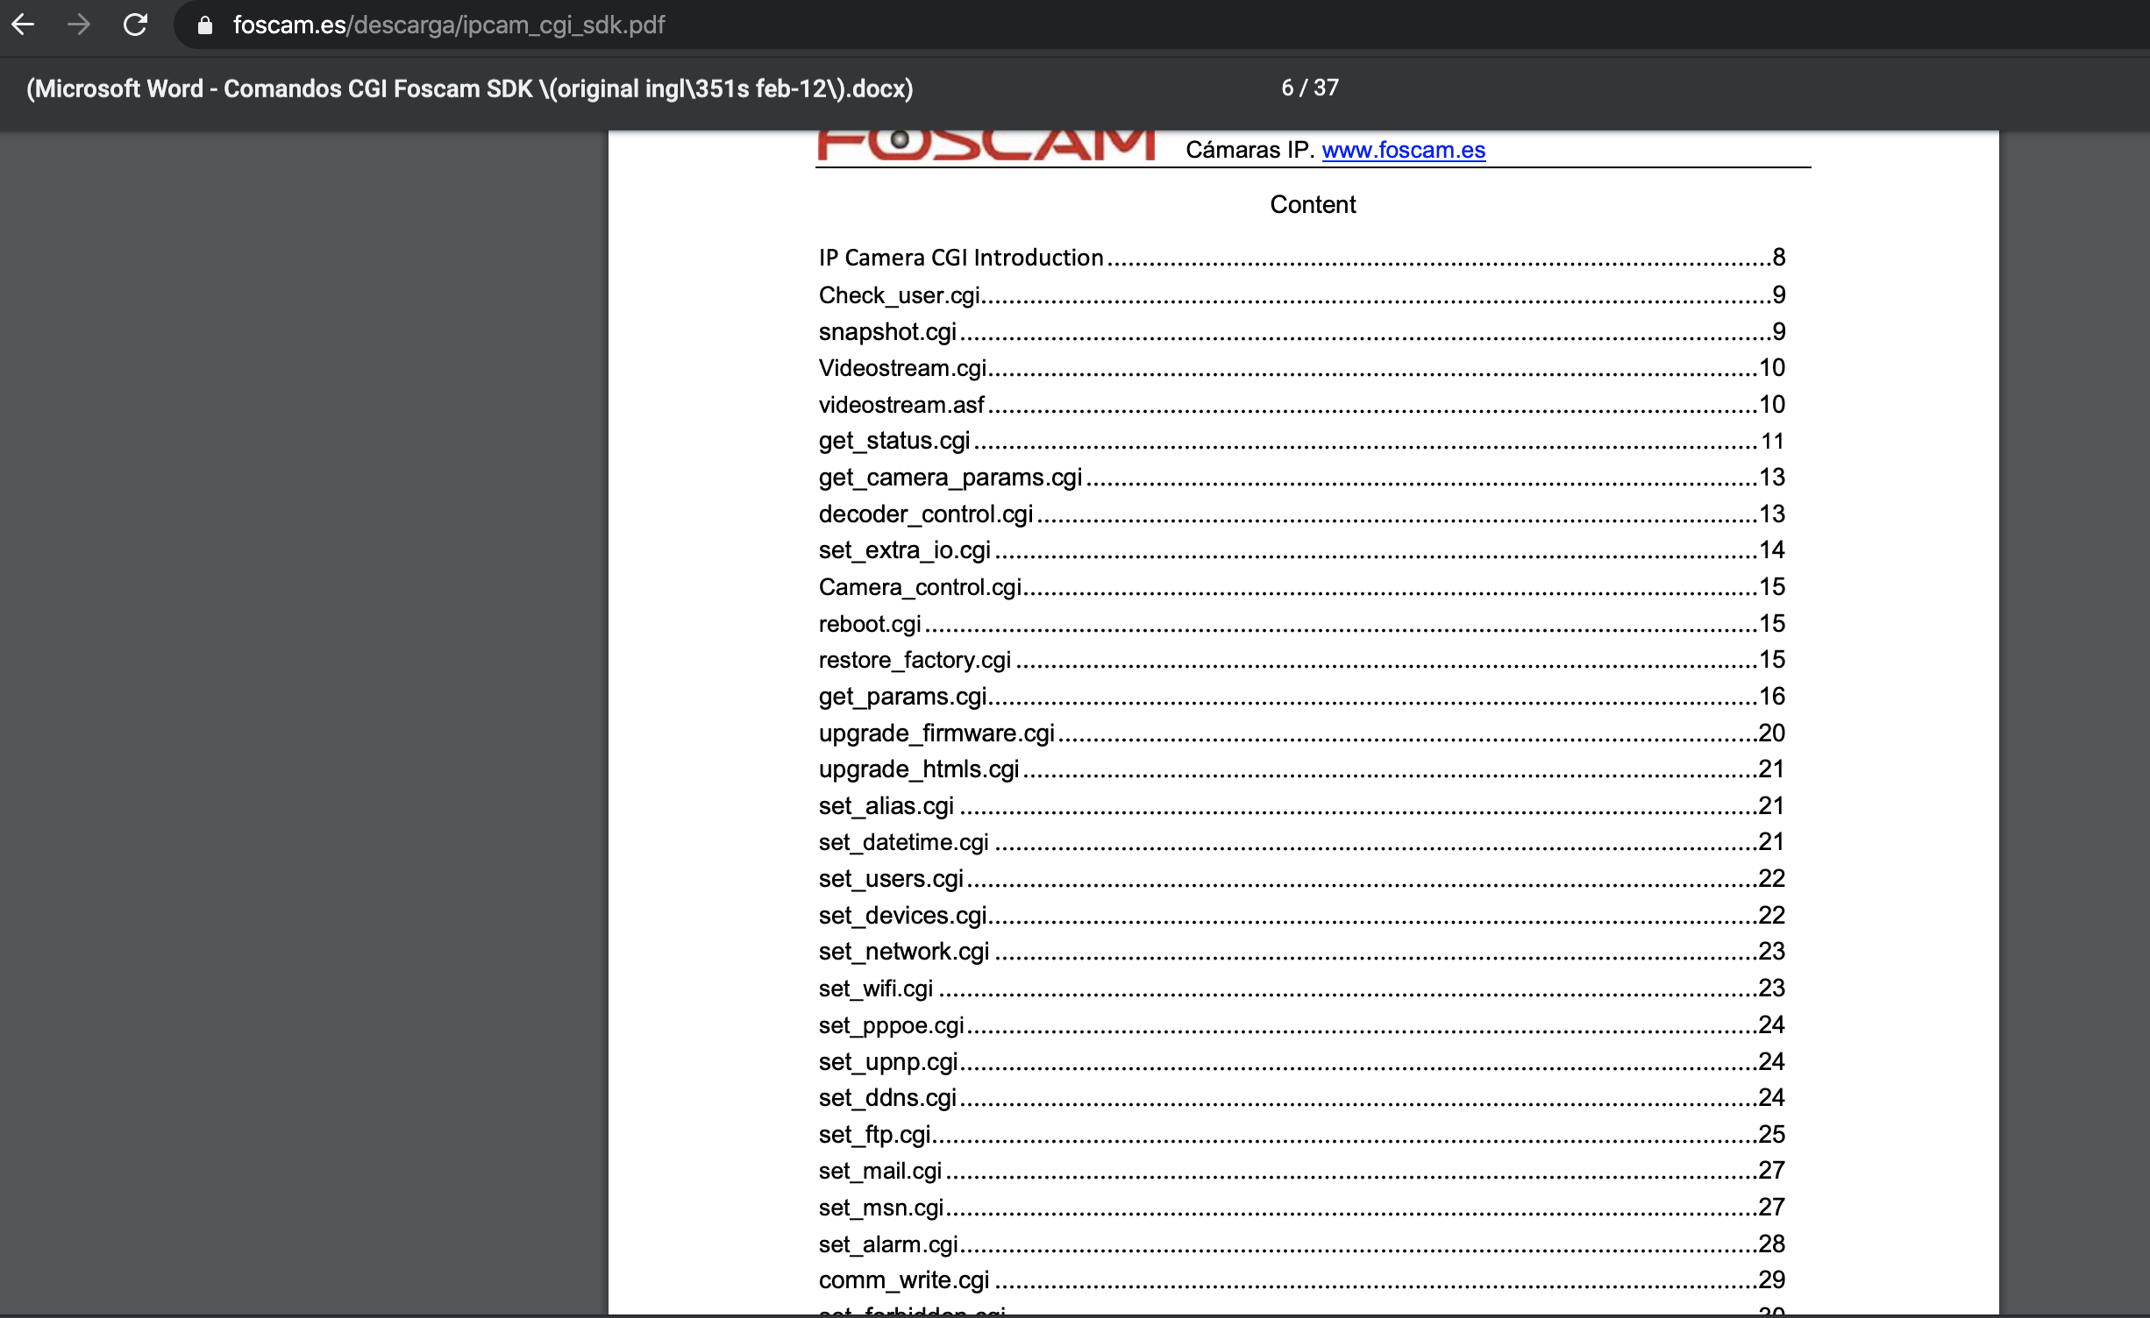
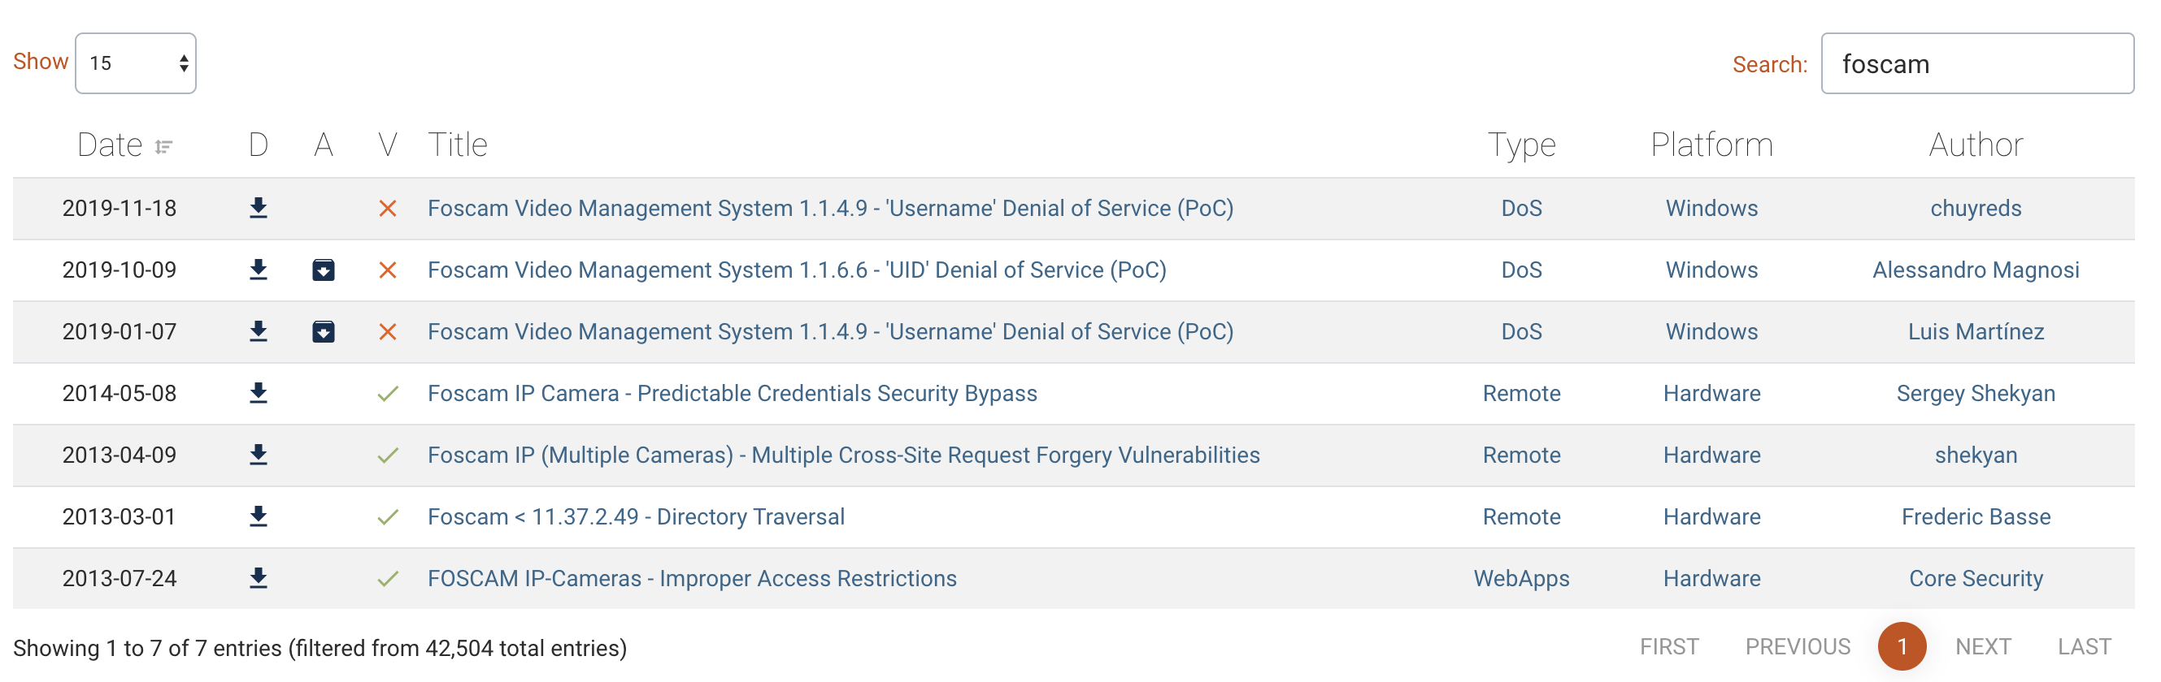
Google hacking
Product information gathering
CGI documentation information(Useful)
CVE history search (All exploits failed)
Firmware download link
http://www.foscam.eu/index.php/productattachments/index/download?id=129

Slide 6
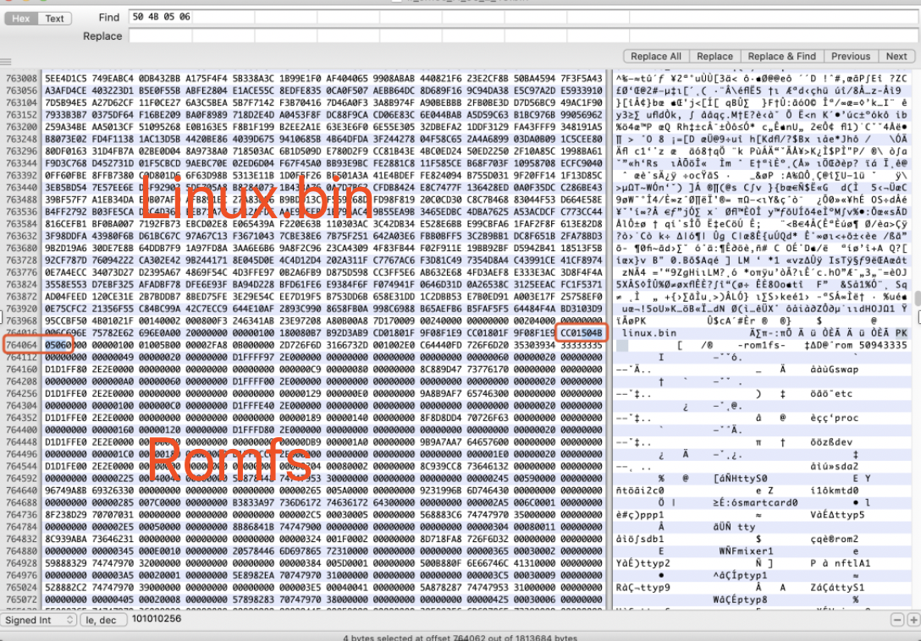
Firmware structure
Compressed Linux.bin (ZIP)
ROMFS

Slide 7
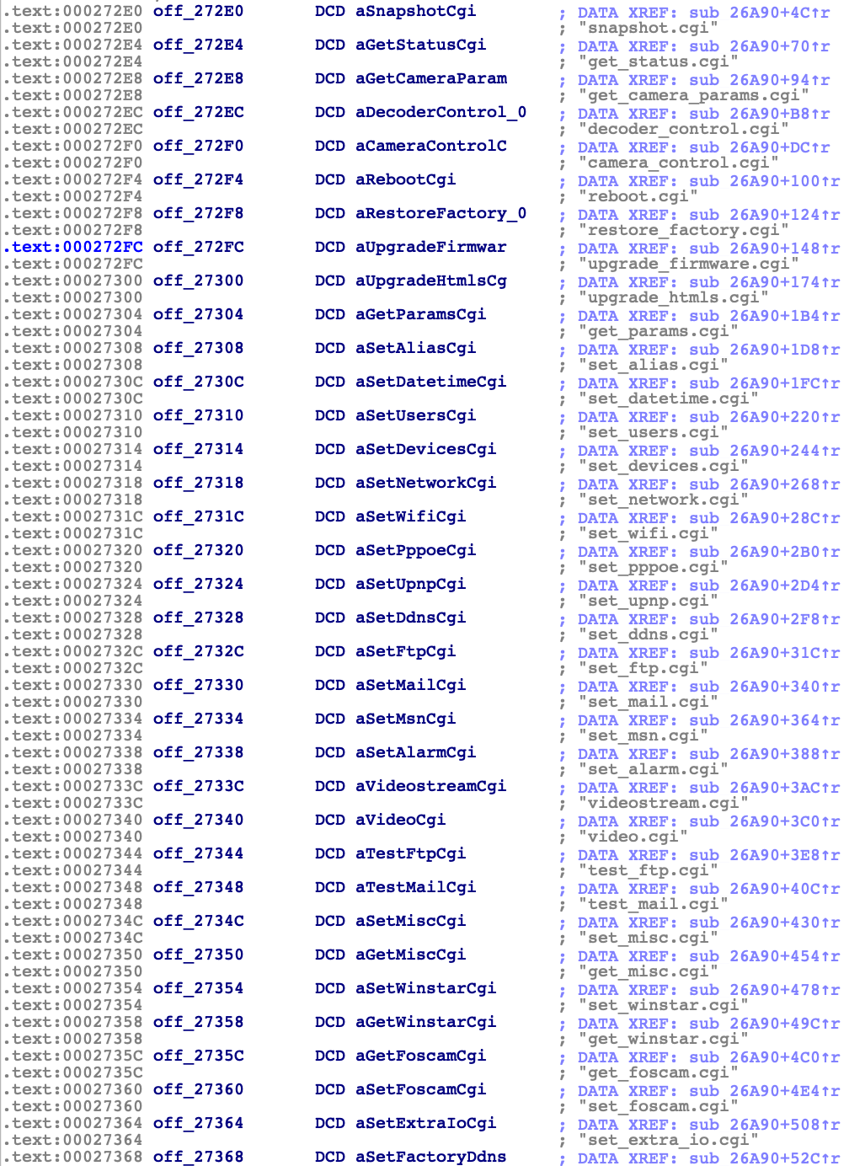
Firmware Reverse engineering
CGI List (Thanks to CGI document. We can know what they are doing easily)

Slide 8
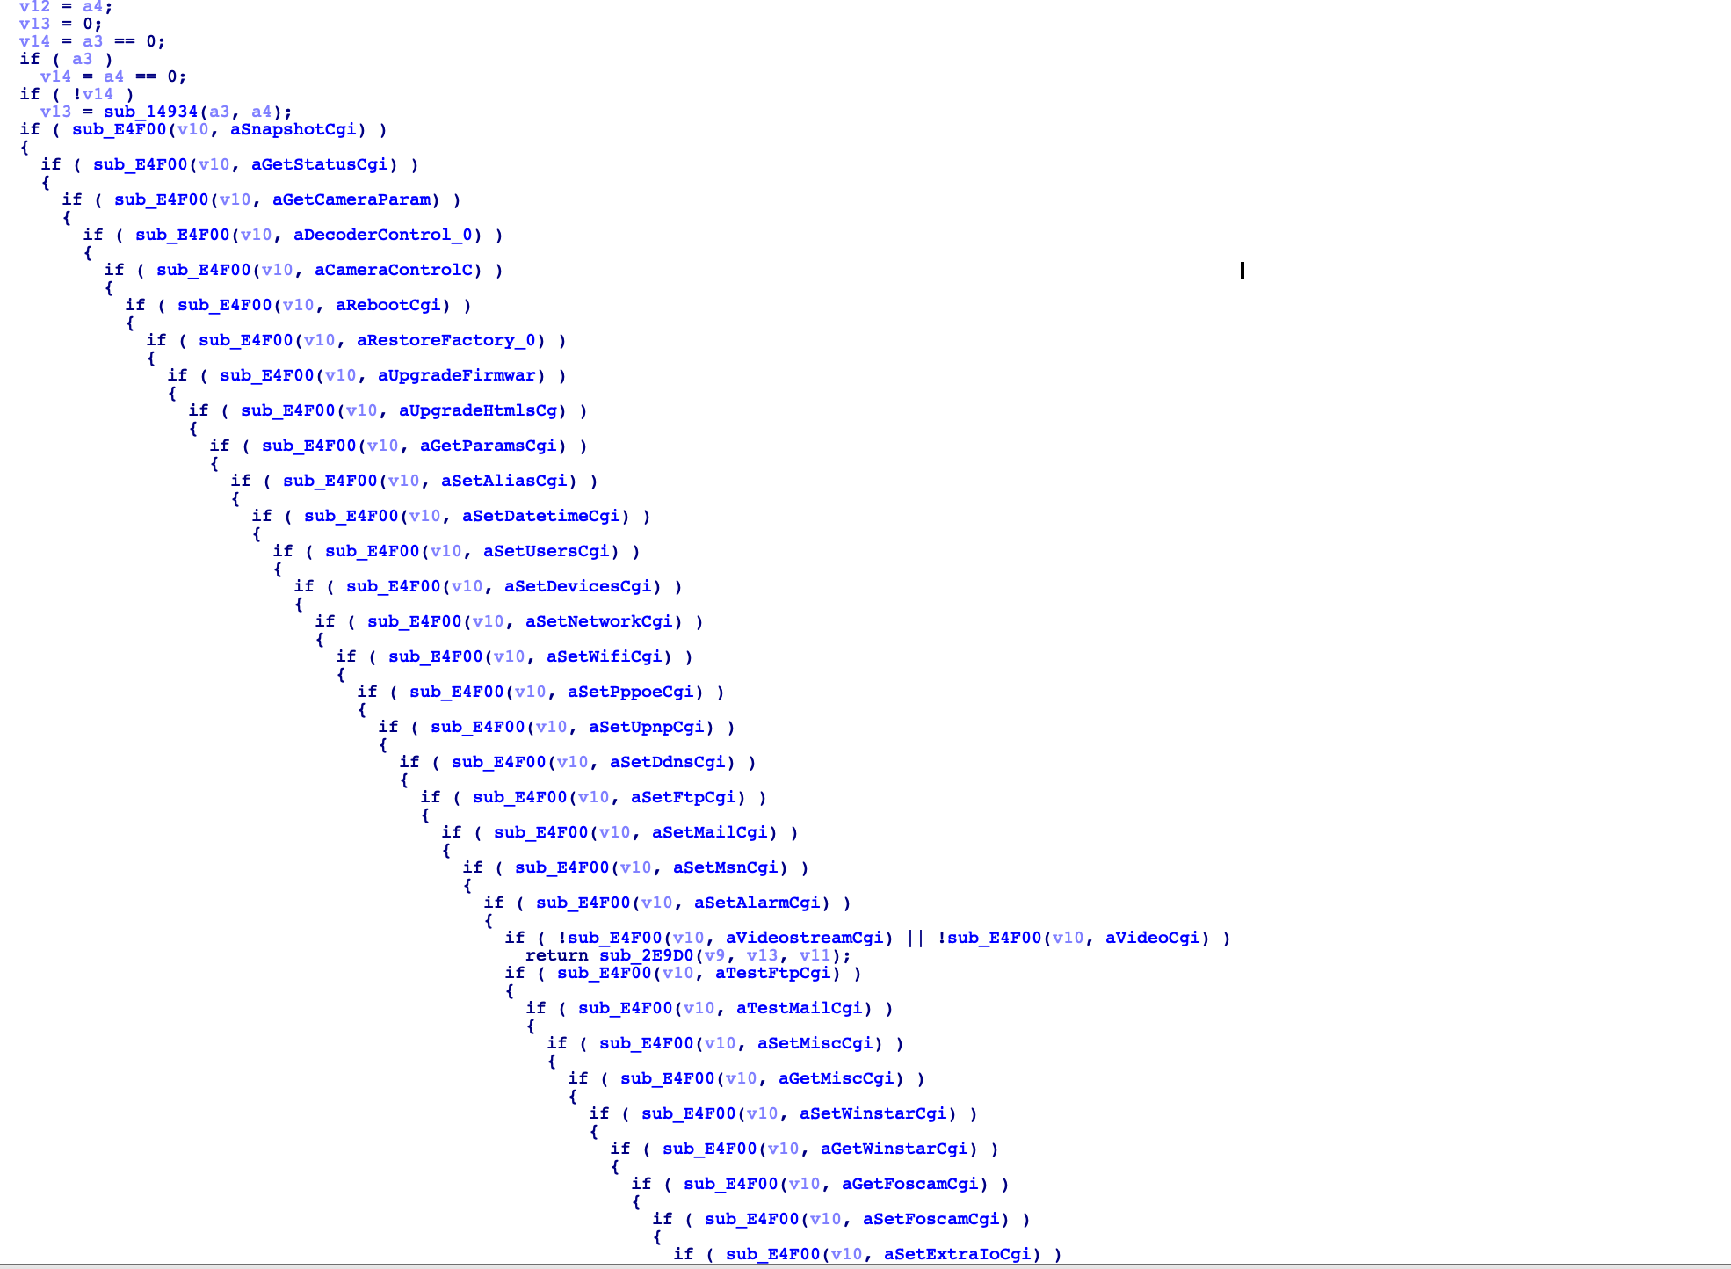
Firmware reverse engineering
Fake CGI…(Actually it only compare strings)

Slide 9
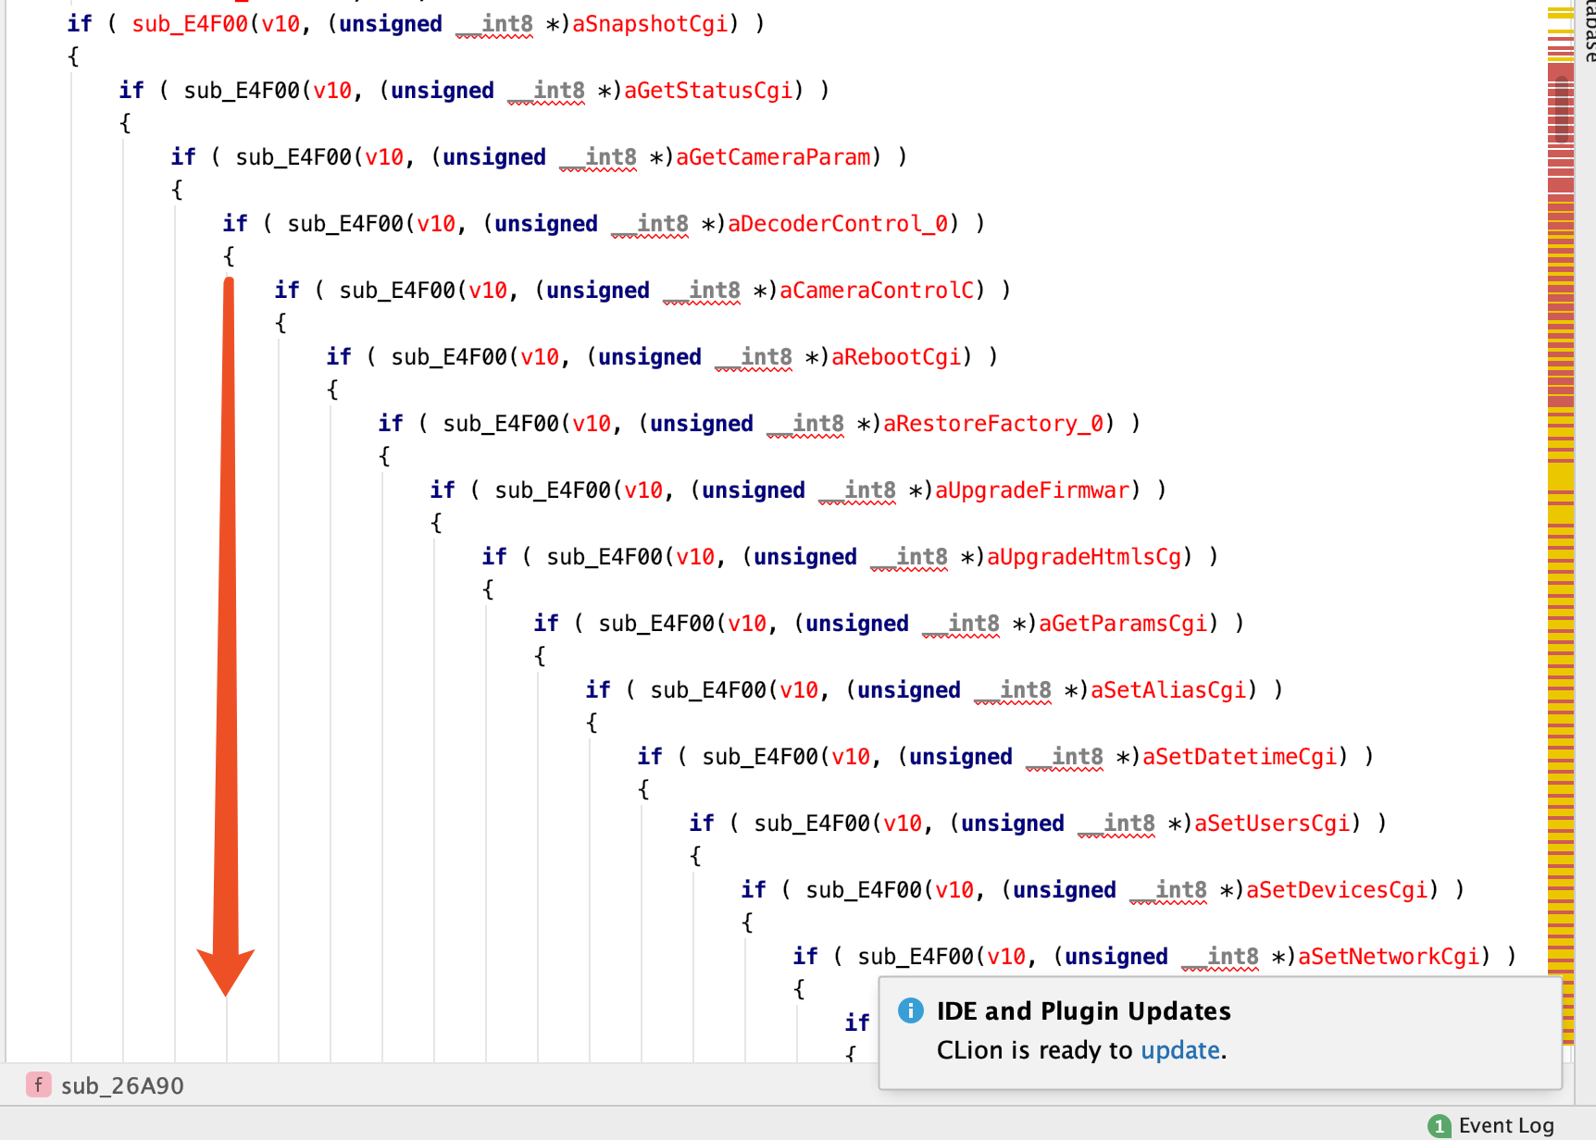
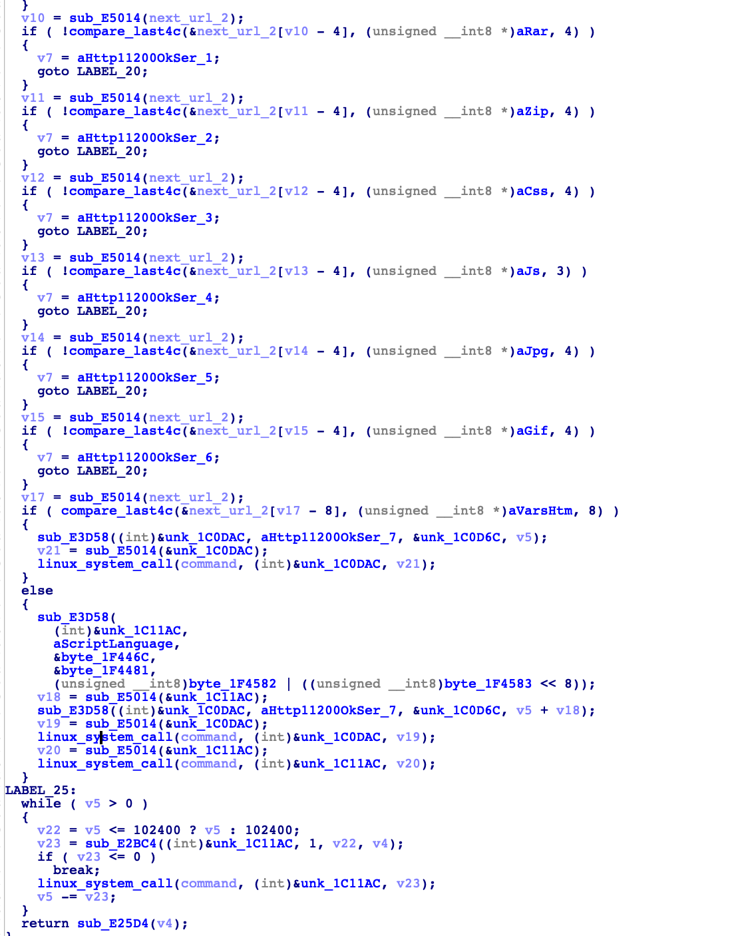
Firmware reverse enginnering
Formatting code by IDE(Clion)
Check it one by one until 4th function. An arbitrary file including vulnerability was found.

Slide 10

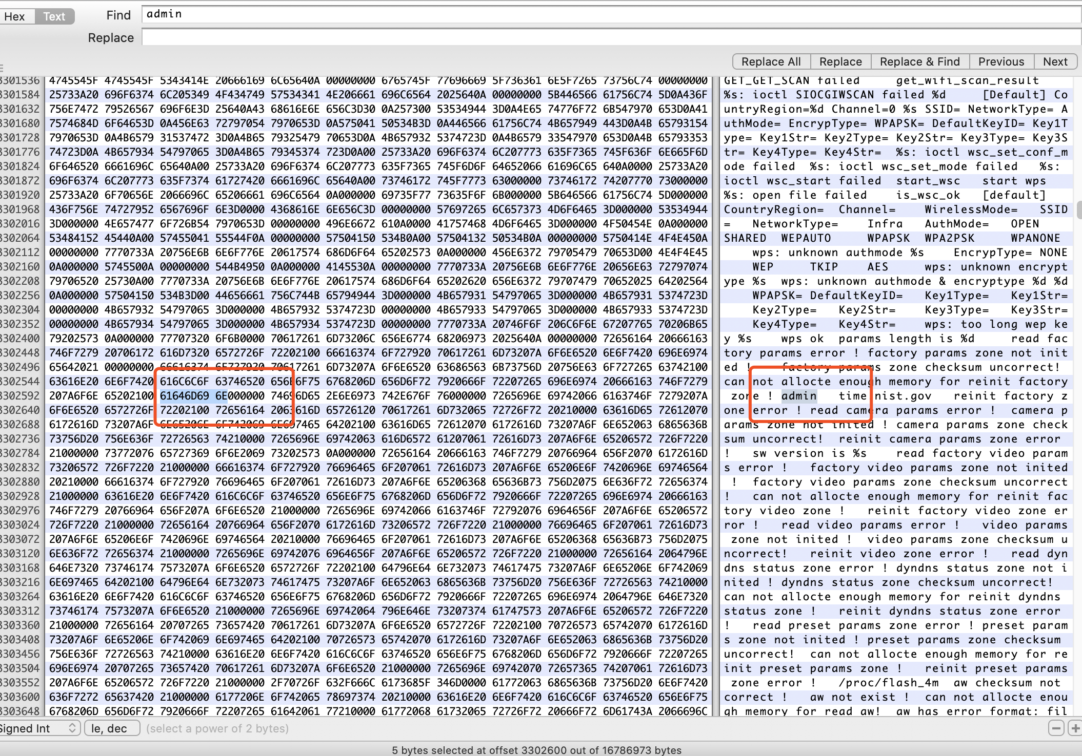
Arbitrary File read
Downloading file from this link without need any authentication
http://100.84.124.155/decoder_control.cgi?command=1&next_url=/proc/kcore
Admin account and Password is plaintext in memory

Slide 11
APP connection
Official App is behind paywall
All open source apps tried didn't seem to work, some reasons:
The Firmware and/or software may out-of-date
App may have been fixed by an update
After the vulnerabilities found earlier, large possibility of vulnerabilities

Slide 12
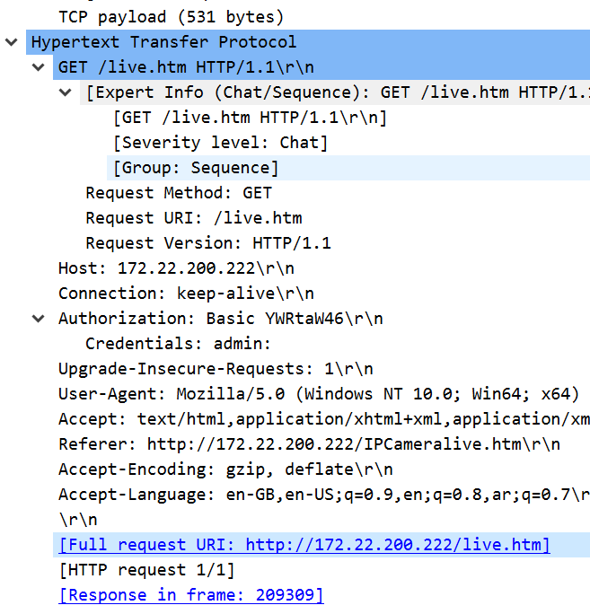
WEb connection
IP Camera Network analysis:
Traffic sent from/to port 80 => (HTTP/1.1)
Authorization method => (Basic)
Credentials are exposed.
Intercepting live stream and images.

Slide 13
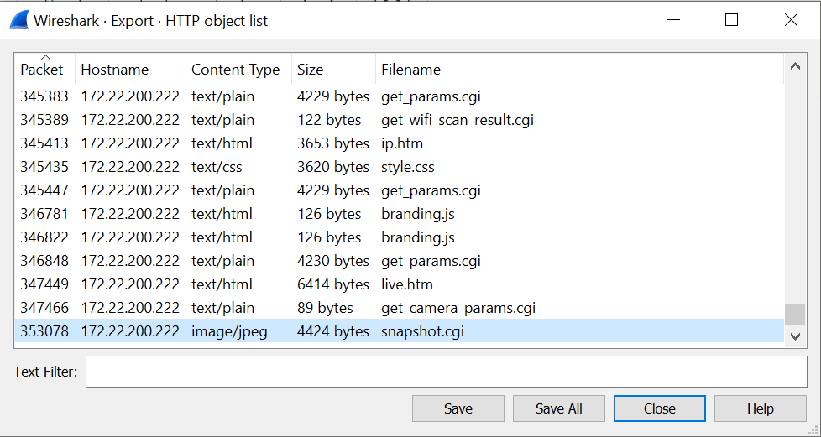

WEb connection
IP Camera Network analysis:
Intercepting live stream and images.
Export the packet
Save .jpeg extension file
Sample picture of my flat ceiling

Slide 14
Attack Mitigations
To ensure the ip camera network secure:
Use HTTPS
TLS/SSL Protocols
Improved authentication
Strong passwords

Slide 15
Common vulnerabilities
Cross-Site Request Forgery
DNS Hijacking
Missing Function Level Access Control
X-FRAME-OPTIONS Missing (Click Hijacking)
No HTTPS
Arbitrary file read

